Slide 1

Simple Network Management….PowerShell!
Stephen Valdinger
@steviecoaster

Slide 2
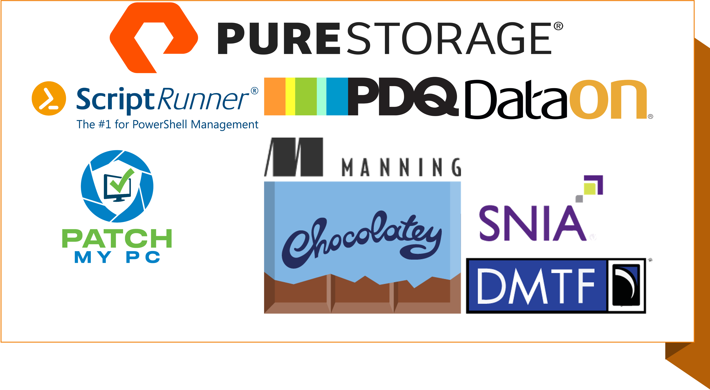

Slide 3
A quick note
Don’t use what you’re about to see in these demos. It’s a demo, and I’m, in a word…..lazy.
Wherever possible, for all that’s right an holy, please use SNMPv3 so you can have authentication.
* Security folks, please make checks payable to Stephen Valdinger

Slide 4
SNMP has been around a very long time….since 1988

Slide 5
SNMP is all about OIDs…..or Object Identifiers

Slide 6
Breaking down an OID
.1
ISO – The group that established the standard

Slide 7
Breaking down an OID
.1.3
This is the arc assigned to organizations that are assigned OIDs
(e.g. Microsoft, Cisco, etc etc)

Slide 8
Breaking down an OID
.1.3.6
This arc is assigned to the Department of Defense
(This $(!% is old, remember)

Slide 9
Breaking down an OID
.1.3.6.1
This is for internet-related OIDs

Slide 10
Breaking down an OID
.1.3.6.1.2
This is for management-related OIDs

Slide 11
Breaking down an OID
.1.3.6.1.2.1
This is assigned to the Management Information Base (MIB) module 2
Which is just a bunch of management objects (nics, procs, mem, etc)

Slide 12
Breaking down an OID
.1.3.6.1.2.1.25
This is for the Host Resources Mib
Uptime, etc, with other hardware more granularly

Slide 13
Breaking down an OID
.1.3.6.1.2.1.25.1
This is the hrSystemUptime object

Slide 14
Breaking down an OID
.1.3.6.1.2.1.25.1.1
This is the Timeticks property of the hrSystemUptime object

Slide 15
Breaking down an OID
.1.3.6.1.2.1.25.1.1.0
The complete object. The trailing .0 is optional in this instance

Slide 16

THANK YOU
Please review this session

